Slide 1
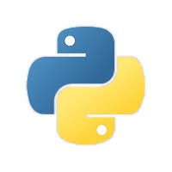
Python : Entry Level Training
Aakaash Ramnath
Data Engineering Consultant
Basic Topics on Python and corresponding exercises
2020 – Jan - 07

Slide 2
Python and it’s features

Slide 3
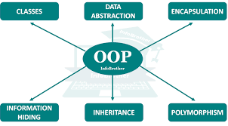
What is python ???
Python is an interpreted, high-level programming language.
Created by Guido van Rossum and first released in 1991, Python's design philosophy emphasizes code readability with its notable use of significant whitespace
General purpose object-oriented programming language.
Clear and easily understandable syntax, portability and easy to learn.
Although often referred as scripting language, it is also used as OOP and system programming.
Huge set of built-in packages for various applications.
Main tool in data science and machine learning fields.

Slide 4
Features of Python
Interpreted language, I see ….
Cross-Platform compatibility, Really???
Object-Oriented Language, OOPs I already knew it. Good…
Extensible, Amazing 😍
Large Standard Library, Hmmm….
GUI Programming support, Ahh !!! You made it pretty…
Free and Open source, Simply Wow !!!!
Integrated, You are my sweety .py
Reference 1 : https://www.javatpoint.com/python-features
Reference 2 : https://data-flair.training/blogs/features-of-python/

Slide 5
Download, Installation & Usage

Slide 6
Download & Installation
How to install and use Python?
Python comes built in for Mac OS and Linux. So you can kickstart by typing python in the shell or terminal to see the version of it
For MS Windows users, download python from https://www.python.org/ ( Please ask for Python setup – aramnath@mycervello.com or lgunasekar@mycervello.com )
For installation steps follow Method 1 in the following link → https://datatofish.com/add-python-to-windows-path/
After installing, type “python” in the command window. It shows the version of python you installed
If it didn’t show, either of it is the reason
Python is not installed properly
Python is not added to the environment variable
To add to environment variable, refer Method 2 → https://datatofish.com/add-python-to-windows-path/
The installation bundle comes with basic python packages and a shell by default
Reference 1 : https://datatofish.com/add-python-to-windows-path/
Reference 2 : https://superuser.com/questions/143119/how-do-i-add-python-to-the-windows-path

Slide 7
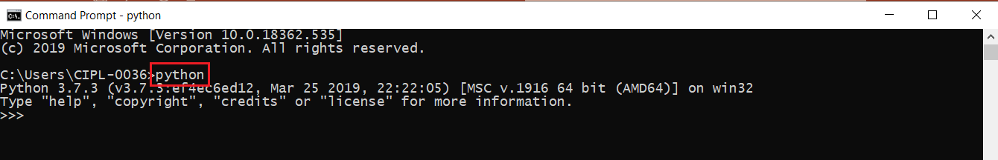
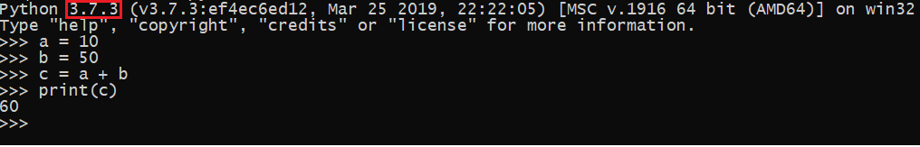
Usage
How to write Python code & Execute???
You can directly start coding in the command window itself. If you type “python” in the console, it will enter Python’s environment.
Image - usage.1
You can start writing your piece of code there and get the result
Image – usage.2
The one marked with red outline in the above image (usage.2) is the Python version

Slide 8
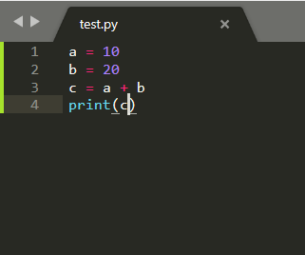
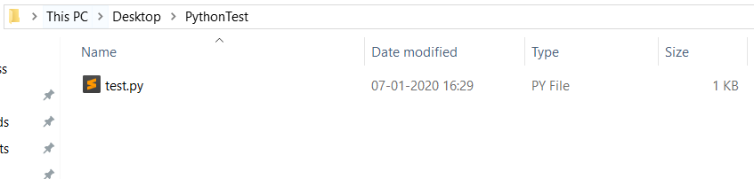
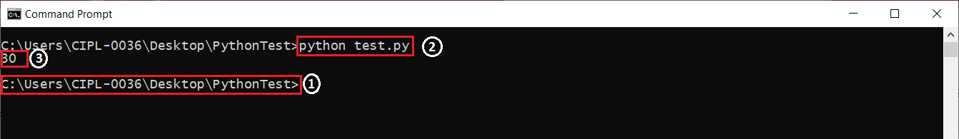
Usage
How to write Python code & Execute???
You can also write python code in a text editor like Notepad++, Sublime Text and preferably not Notepad since Python reads the code by indentation similar to how Java or C++ reads by braces {}.
Save the file with extension .py
Open the command line and navigate to the location where this code is saved and run this “python <filename>.py” to execute the code
1 → Path where the Python code is stored
2 → That’s how you execute the code
3 → Output

Slide 9




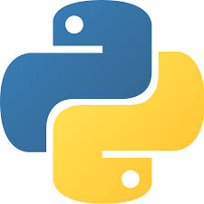

Usage
How to write Python code & Execute???
You can also use other Python Development Environments
General Editors & IDEs with Python Support
Eclipse + PyDev
Sublime Text
Atom
GNU Emacs
Vi/Vim
Visual Studio
Visual Studio Code
Python specific Editors and IDEs
PyCharm
Spyder
Thonny
Python computers like Anaconda

Slide 10
Learning to code

Slide 11
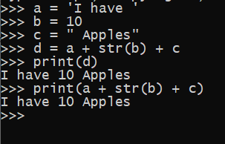
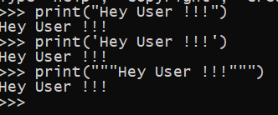
Basics of Python
Data Types
Variables are containers for storing data values. Unlike other programming languages, Python has no command for declaring a variable. A variable is created the moment you first assign a value to it.
Data Types in Python
Text Type: str
Numeric Types: int, float, complex
Sequence Types: list, tuple, range
Mapping Type: dict
Set Types: set, frozenset
Boolean Type: bool
Binary Types: bytes, bytearray, memoryview
Classic exercise whatever language you learn – Print Hello World !!!. But let’s do something different. Print Hey User !!!. No much difference LOL…
There are 3 ways you can declare string in Python
“One way”
‘Another way’
“””Other way””” (Used for multi-line strings)
You can convert anything explicitly into String datatype by using str() in built function

Slide 12
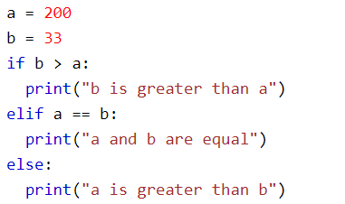


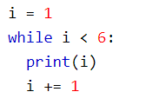

Basics of Python
Condition blocks & Looping
If …. else (Conditional block)
Used with logical operators to check the conditions
Will go into if or elif block only if the condition against them returns True
If none of the if or elif conditions are True, only then it executes the statement in else block
For (Looping)
Used for iterating over sequence
While (Looping)
One of the primitive looping in Python
1
2
3
4
5

Slide 13
Basics of Python
Topics to learn
Type casting
Usage of Conditional and Looping blocks
Iteration and accessing
List (Iterate and access the elements)
Tuple
Range
Dict (Access elements by key as well as index)
Sets

